Slide 1
CSS
Website layout

Slide 2
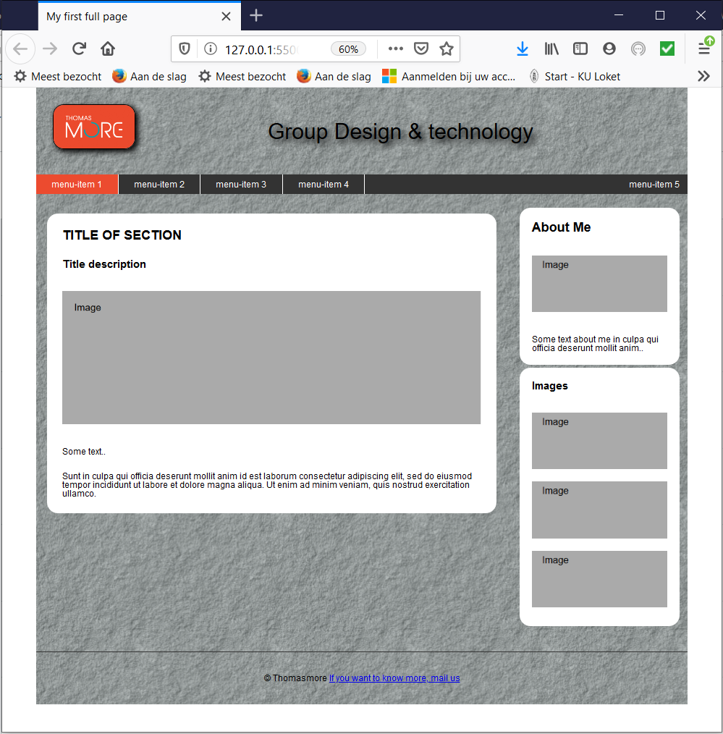

Slide 3
steps
HTML define blocks:
Put all related elements in a <div>
Second, third level?
CSS:
Position the blocks
Define borders, margins and paddings
Other CSS design(text, headings, …)

Slide 4
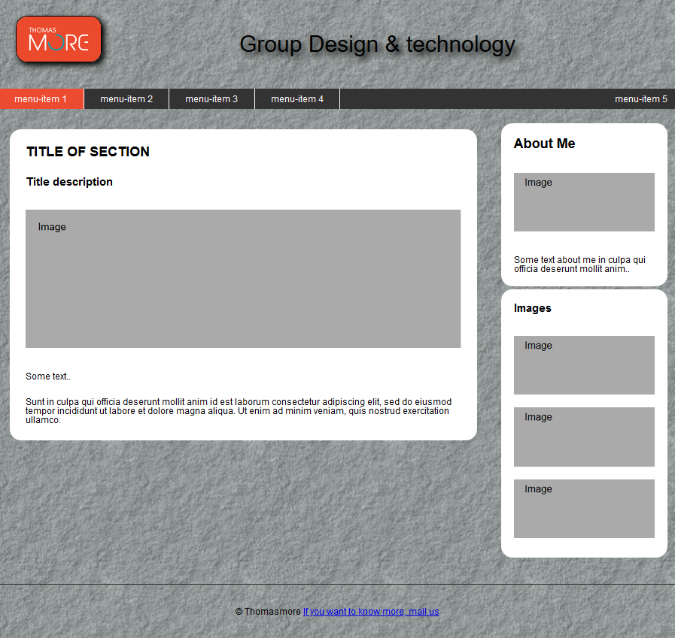
1. html Define the blocks
header
navigation
content
footer

Slide 5
Html structure
<body>
<header>
</header>
<nav>
</nav>
<div class="content">
<div class="leftcolumn"> </div>
<div class="rightcolumn"> </div>
</div> <!-- einde content -->
<footer>
</footer>
</body>
Logo, title
List with links and sublist
Content of the page
CMS: fill dynamically
with data from database
Extra info

Slide 6

Header
Logo
title
<header>
<img src="logoLM.jpg" alt="logo thomasmore"/>
<p>
Group Design &amp; technology
</p>
</header>

Slide 7
Navigation
<nav>
<ul>
<li><a href="#">menu-item 1</a></li>
<li><a href="#">menu-item 2</a></li>
<li><a href="#">menu-item 3</a>
<ul>
<li><a href="#">menu-item 3.1</a></li>
<li><a href="#">menu-item 3.2</a></li>
</ul>
</li>
<li><a href="#">menu-item 4</a></li>
<li><a href="#">menu-item 5</a></li>
</ul>
</nav>

Slide 8
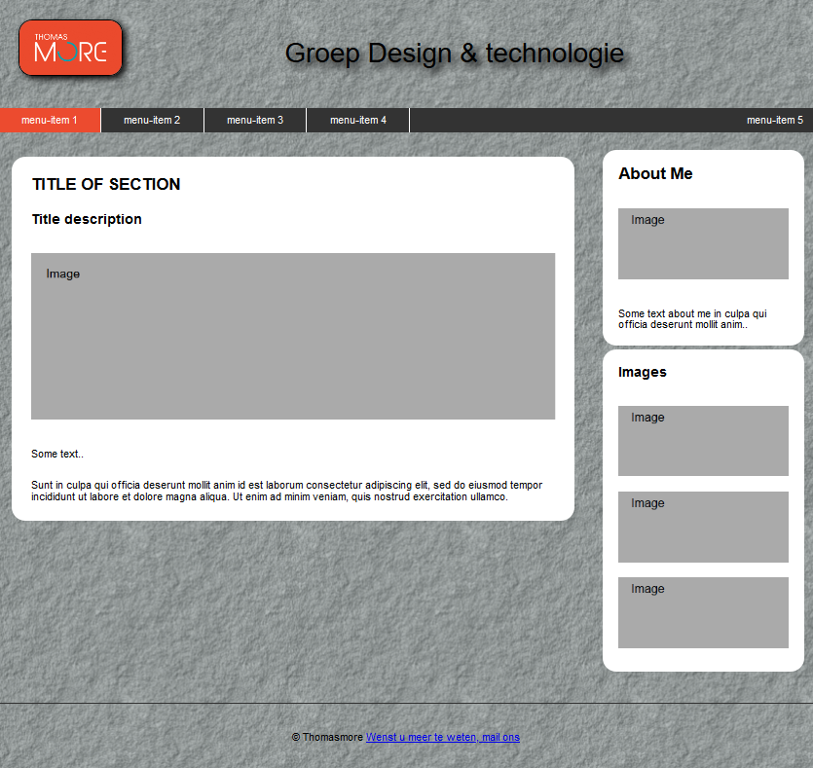
content
<div>
<div class="leftcolumn">
<div class="card">
</div>
</div>
<div class="rightcolumn">
<div class="card">
</div>
<div class="card">
</div>
</div>
</div>
2 columns containing 1 or more ‘cards’ each

Slide 9
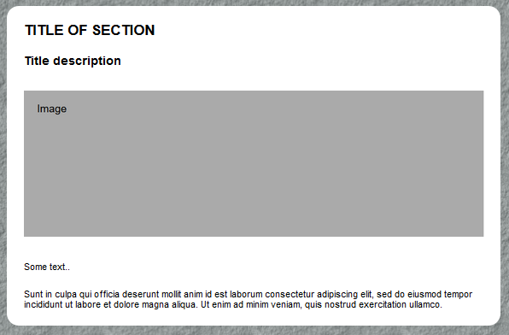
Left column
title
Smaller title
Note: div is non-text-block element
=> no text directly in between <div> </div>
image
2 paragraphs
<div class="leftcolumn">
<div class="card">
<h2>TITLE OF SECTION</h2>
<h3>Title description</h3>
<p>
<img src="img/ImageLarge.png" alt="fakeimg" />
</p>
<p>Some text..</p>
<p>Sunt in culpa qui officia deserunt … ullamco.</p>
</div>
</div>

Slide 10
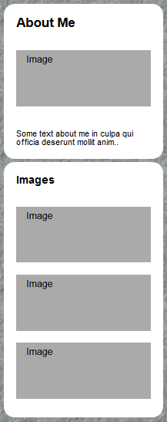
right column
<div class="rightcolumn">
<div class="card">
<h2>About Me</h2>
<p>
<img src="img/ImageSmall.png" alt="fakeimg" />
</p>
<p>Some text about me in …anim..</p>
</div>
<div class="card">
<h3>Images</h3>
<p>
<img src="img/ImageSmall.png" alt="fakeimg" />
<img src="img/ImageSmall.png" alt="fakeimg" />
<img src="img/ImageSmall.png" alt="fakeimg" />
</p>
</div>
</div>

Slide 11
footer
<footer>
<p>
&copy; Thomasmore
<a href="mailto:">If you want to know more, mail us</a>
</p>
</footer>
result

Slide 12
2. CSS: overall layout settings
CSS reset
why?
Overall settings:
Define font type, font-size for paragraphs and headings, insert padding and margin
result

Slide 13
CSS: add Wrapper
Wrapper
<div> surrounding the full page
Why?
Set page width within limits
Center page in browser
result
.wrapper {
min-width:500px;
max-width:1200px;
margin:0px auto 0px auto;
background-image: url('../img/background-tile.png');
}

Slide 14
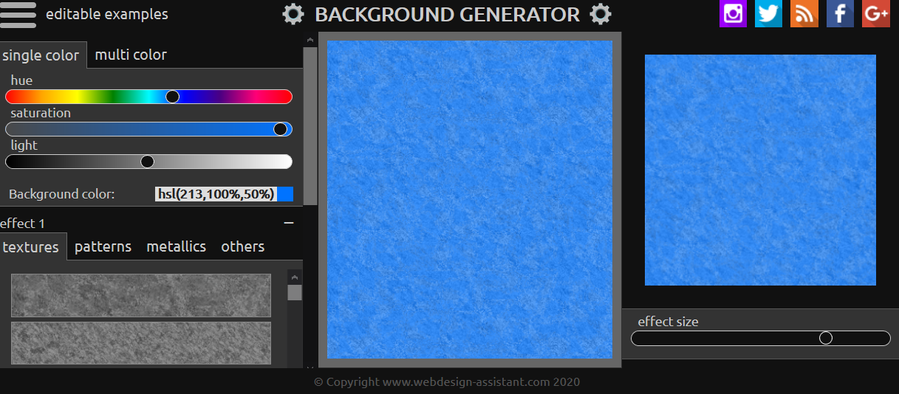
Create Background tile
Background tile generator:
https://webdesign-assistant.com/background-editor/background-generator.php

Slide 15
CSS: header
Adjust logo size and move title next to logo:
HTML: add class logo to img in header
CSS: .logo {width:150px;float: left}
Push menu bar under header:
set header hight via ::after
result
header::after {
content: "";
display: block;
clear: both;
}
result

Slide 16
CSS: header
Enlarge title text, add shadows, …:
Logo: round corners and add shadow:
Move logo away from edge of header:
.title{
font-size:40px;
text-shadow: black 7px 7px 10px;
text-align: center;
padding: 20px 0px;
}
.logo{
border:1px solid black;
border-radius: 20px;
box-shadow:5px 5px 10px black;
}
result
header { padding: 30px; }

Slide 17
CSS: navbar
Set navbar background color, put list elements next to each other, put last one on the right without border
/* background color of navbar */
nav { background-color: #333; }
/* place menu elements horizontally and add border to list elements */
nav li {
float: left;
width: 150px; /*needed to work with drop down*/
border-right: 1px solid white;
}
/*remove border from last list el and float that one to the right*/
nav>ul>li:last-child {
border-right: none;
float: right;
width: auto;
}
result

Slide 18
CSS: navbar
Where is the background color of the navbar?
floats cause navbar to have height 0
How to enforce height?
nav ul::after {
content: "";
display: block;
clear: both;
}
result

Slide 19
CSS: navbar link layout
/* style the menu elements*/
nav a {
display:block;
color: white;
text-decoration: none;
text-align:center;
padding: 10px 15px;
}
/* style the active menu button */
.active {
background-color: #ec4b2f;
}
/* change color on hover except for the active menu item*/
nav a:hover:not(.active) {
background-color: #CCC;
color: black;
}
result

Slide 20
CSS: navbar drop down
/* hide lists level 2 */
nav li ul {
position: absolute;
width:150px;
display: none;
}
nav li li {
background-color: #333;
border-right: none;
}
/* show list level 2 on hover of top element */
nav li:hover ul {
display: block;
}
result

Slide 21
CSS: content 2 columns
.content {
padding: 20px;
}
/* create two columns that float next to each other */
.leftcolumn {
float: left;
width: 70%;
}
.rightcolumn {
float: left;
width: 25%;
margin-left:5%;
} /* Clear floats after the columns */
.row::after {
content: "";
display: block;
clear: both;
}
result

Slide 22
CSS: content cards and images
/* style the cards */
.card {
background-color: white;
border-radius:20px;
padding:1%;
margin: 2% 0;
width: 100%;
}
/* style the fake images */
.fakeimg {
width: 100%;
margin:10px auto;
}
.small {
height: 80px;
}
result

Slide 23
CSS: footer
footer {
padding: 20px;
text-align: center;
border-top:2px solid #333;
margin-top: 20px;
}
result

